Slide 1
Models with spatial variation
Modelling Fall 2026
Frederik Dalby
Lecture (advec-diff eq, PDE coordinates) 20 min
Exercises (30 min)
Mini project 1

Slide 2
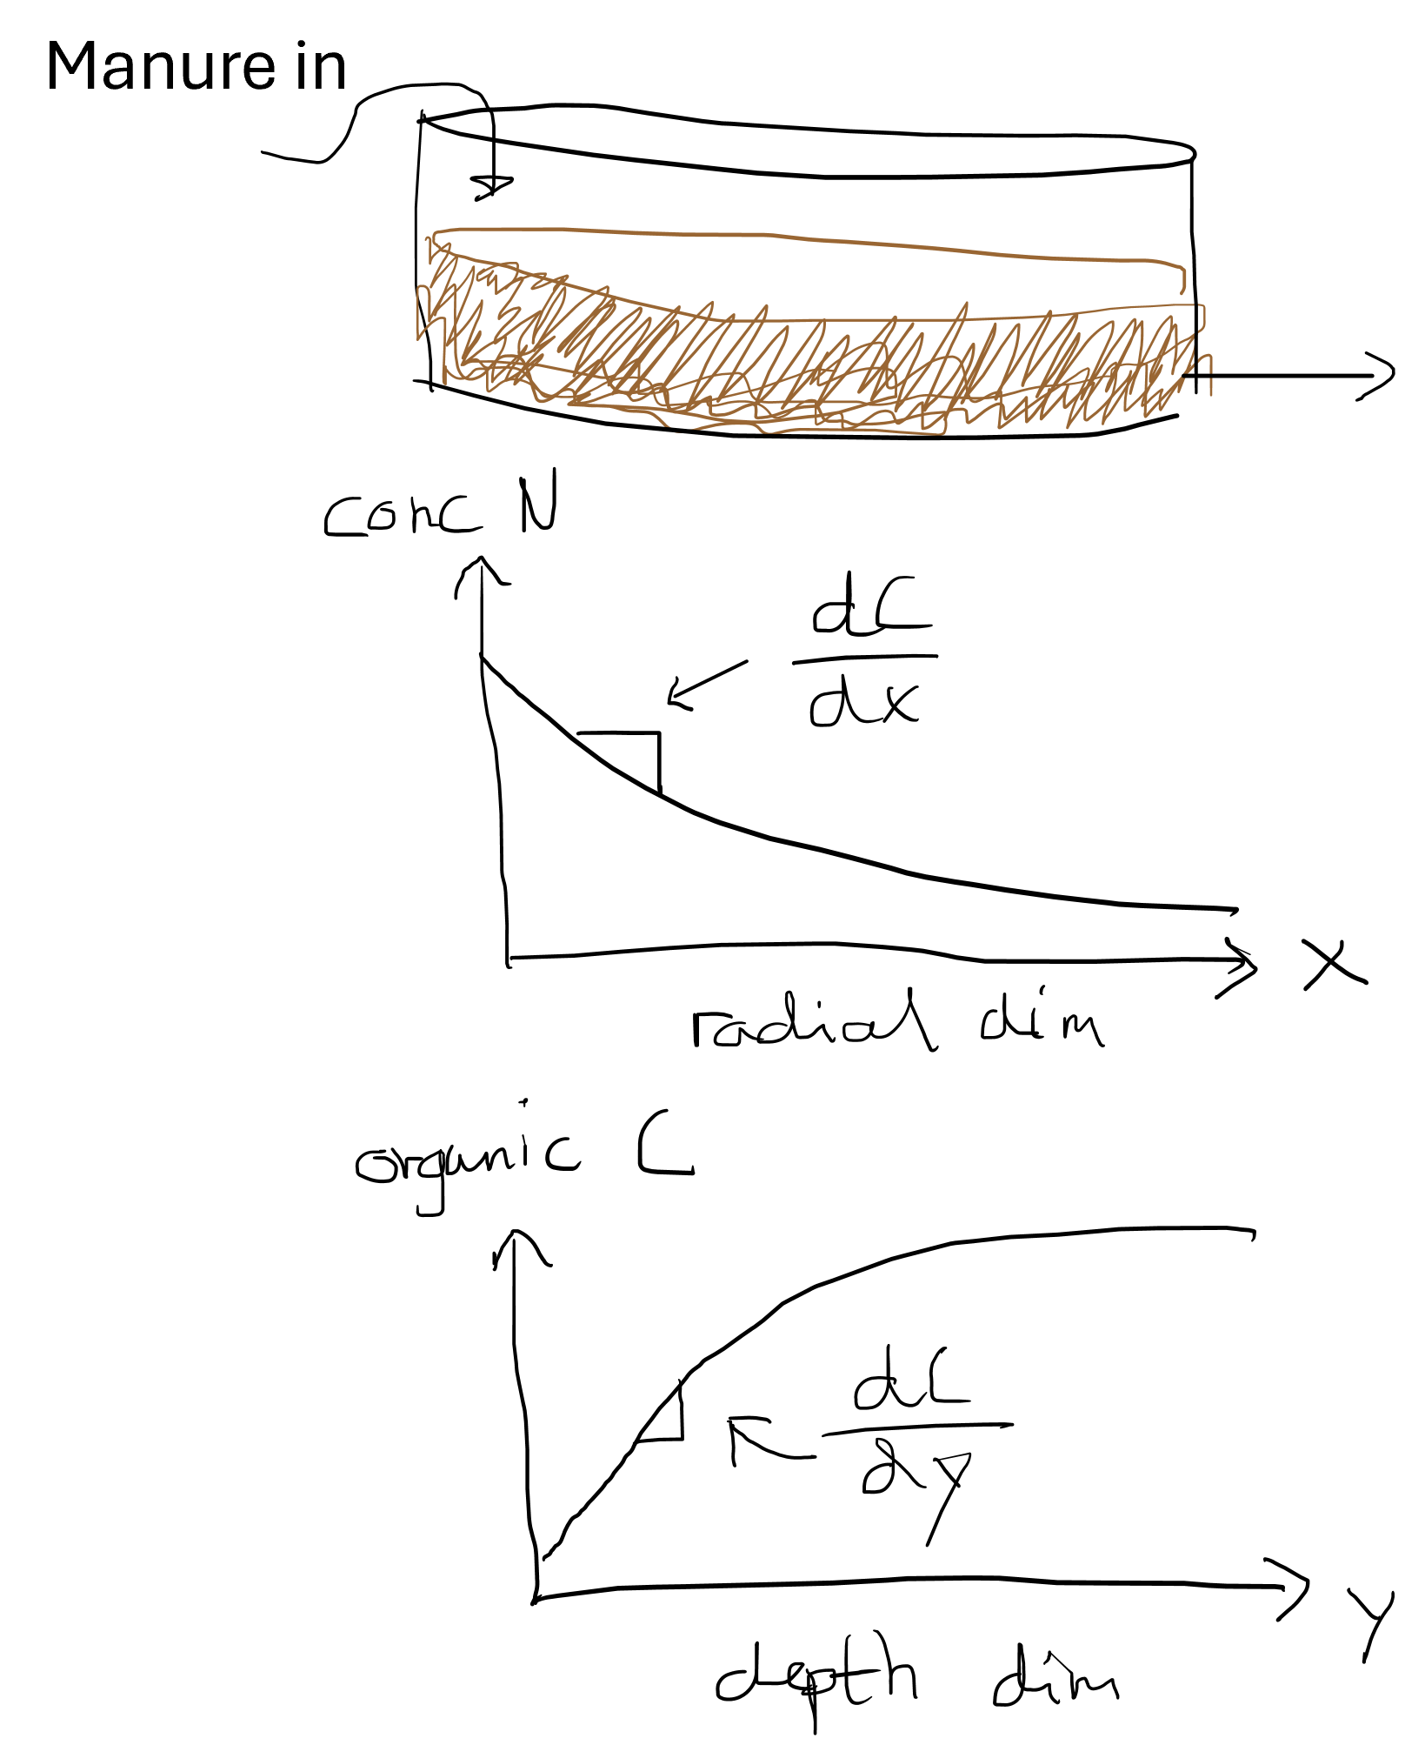
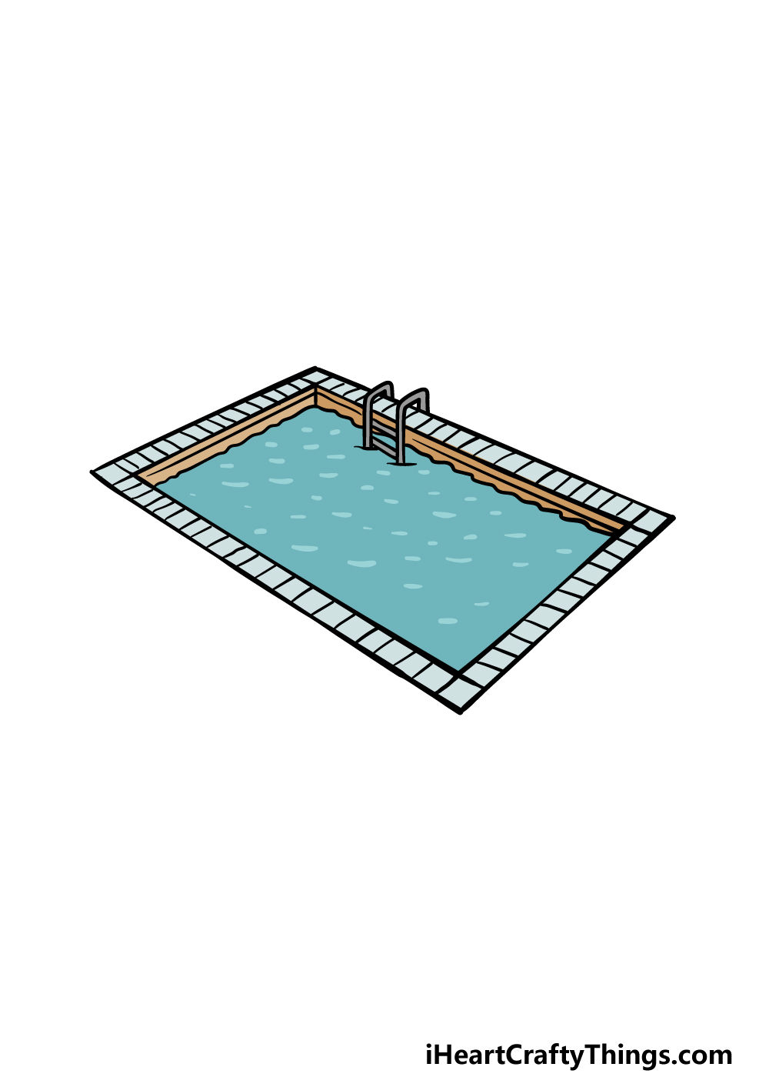
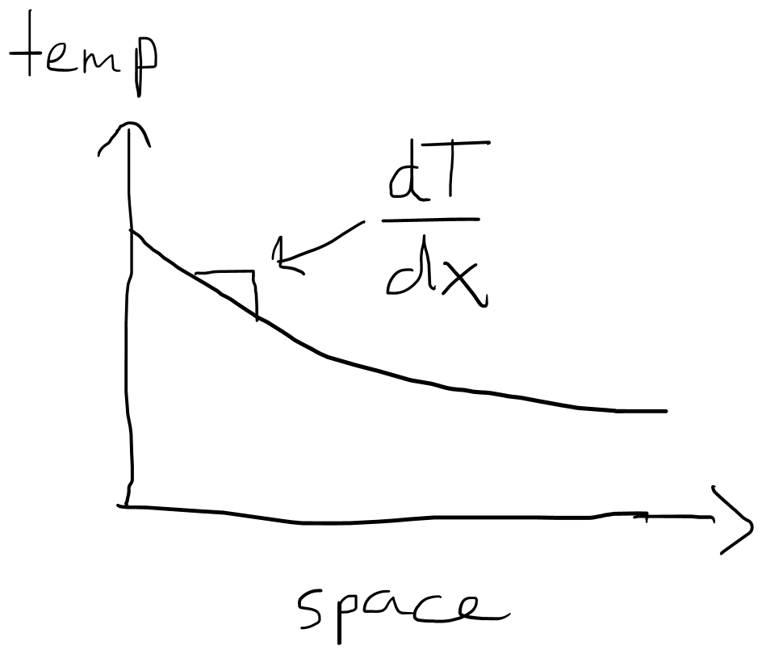
Examples of spatial
Manure out
Warm water in
water out

Slide 3
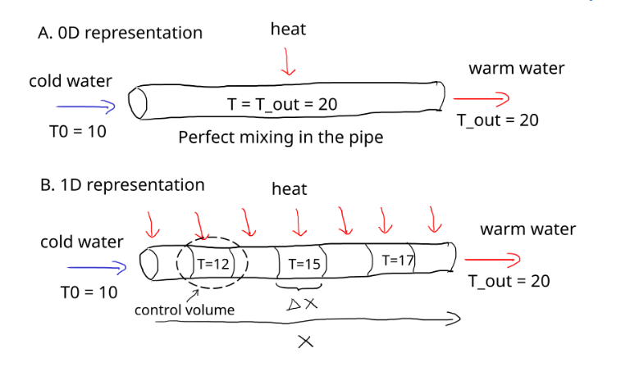



From ODE to PDE
$$acc=in −out+gen −con$$
”In” and ”out” terms can be thought of as sums of both diffusion and advection for the 0D problems
$$acc=in by advection −out by advection+in by diffusion −out by diffusion+gen−con$$
Advection
Conduction
Advection
Diffusion

Slide 4
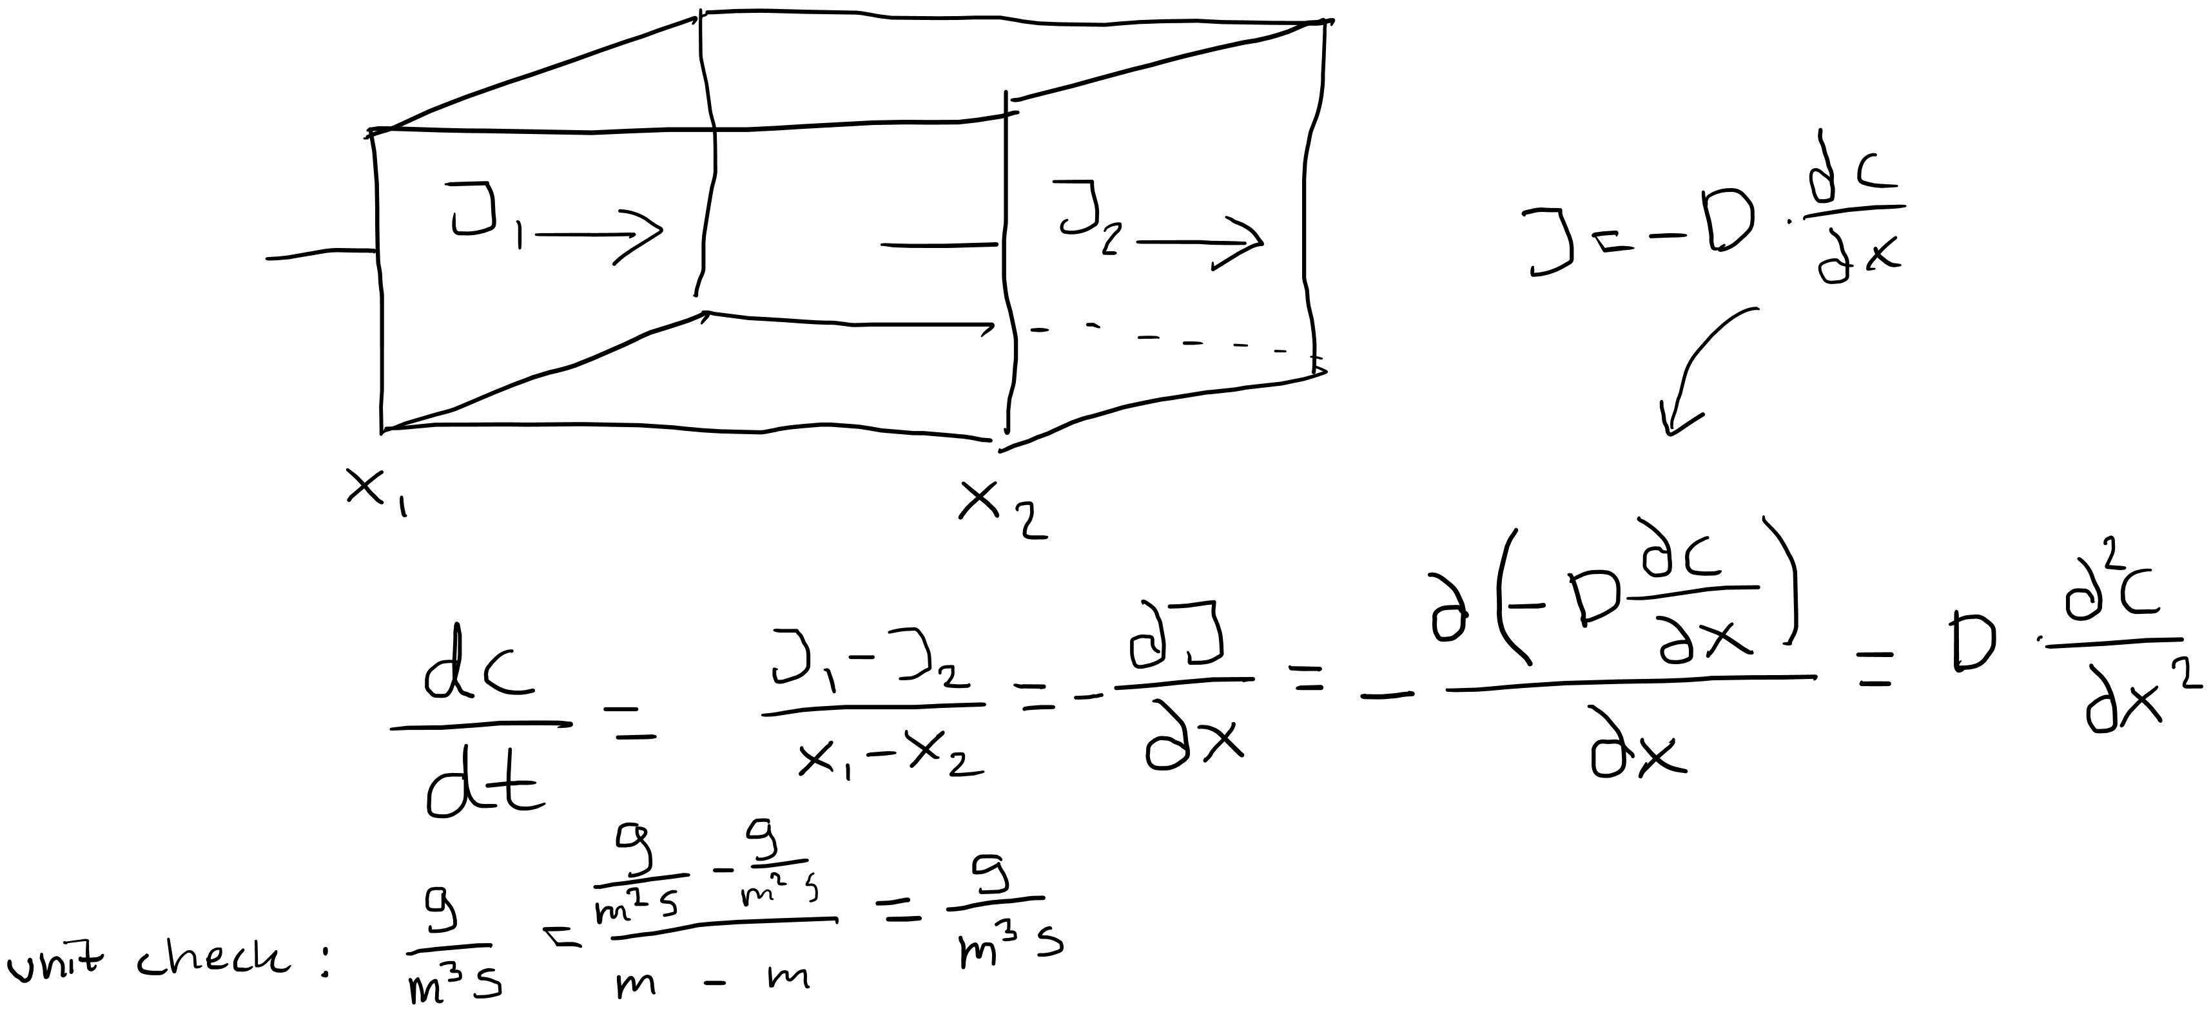
Ficks law + law of conservation leads to Ficks second law ($\frac{∂C_{A}}{∂t}=D\frac{∂^{2}C_{a}}{∂x^{2}}$)
Conservation law says: accumulation = flow in – flow out + generated - consumed

Slide 5




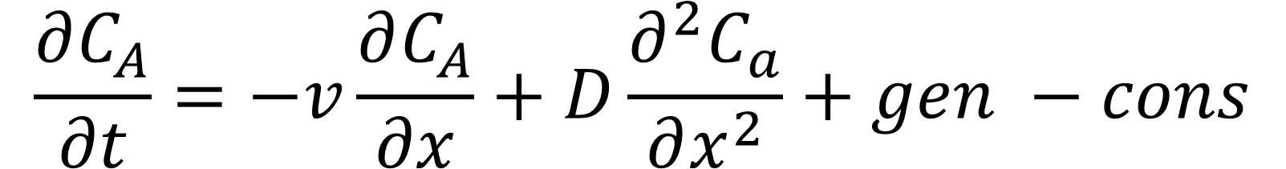


$$\frac{∂C_{A}}{∂t}=−v\frac{∂C_{A}}{∂x}+D\frac{∂^{2}C_{a}}{∂x^{2}}+gen −cons$$
Is the advection-diffusion-reaction equation → common in chemical/biological engineering
What if we had spatial variation in more dimensions??
Mass balance
Governing equation for energy
Governing equation for mass
Heat balance
$$\frac{∂T}{∂t}=−∇∙\left(vT\right)+ α∇^{2}T+S$$
advection
diffusion
reaction (generation)
Thermal advection
Thermal diffusion
Heat source (generation)
Conductivity coefficient
$$α= \frac{k}{ρC_{p}}$$
$$=$$
Heat capacity
Thermal diffusivity
Density

Slide 6
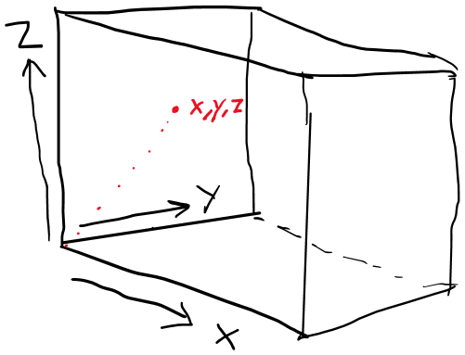
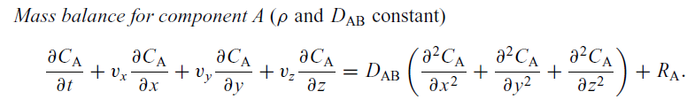
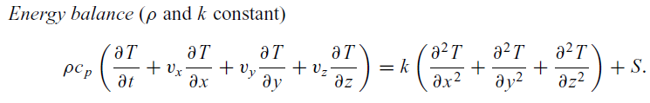
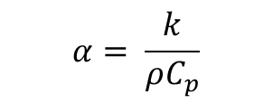
Coordinates of PDE equations
Rectangular (cartesian)
Governing equation for mass
Governing equation for energy
$$α= \frac{k}{ρC_{p}}$$
thermal diffusivity

Slide 7
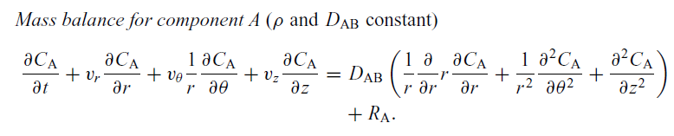
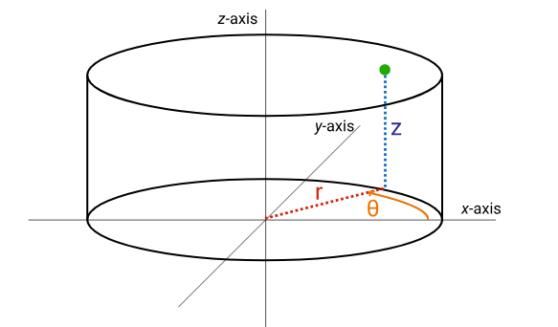
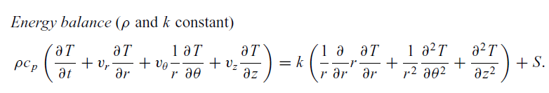
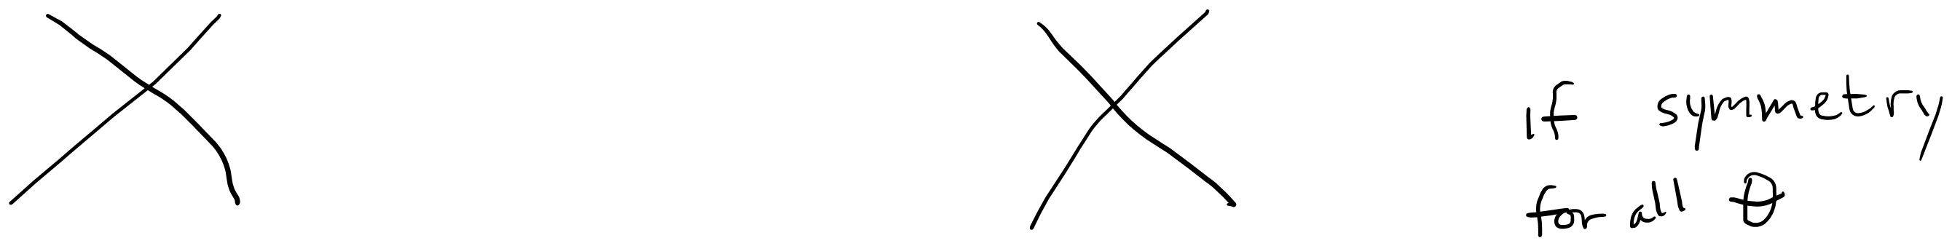
Cylindrical coordinates
Governing equation for mass
Governing equation for energy
Governing equation for mass

Slide 8
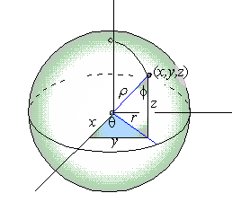
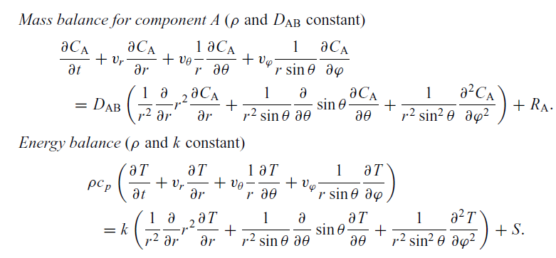
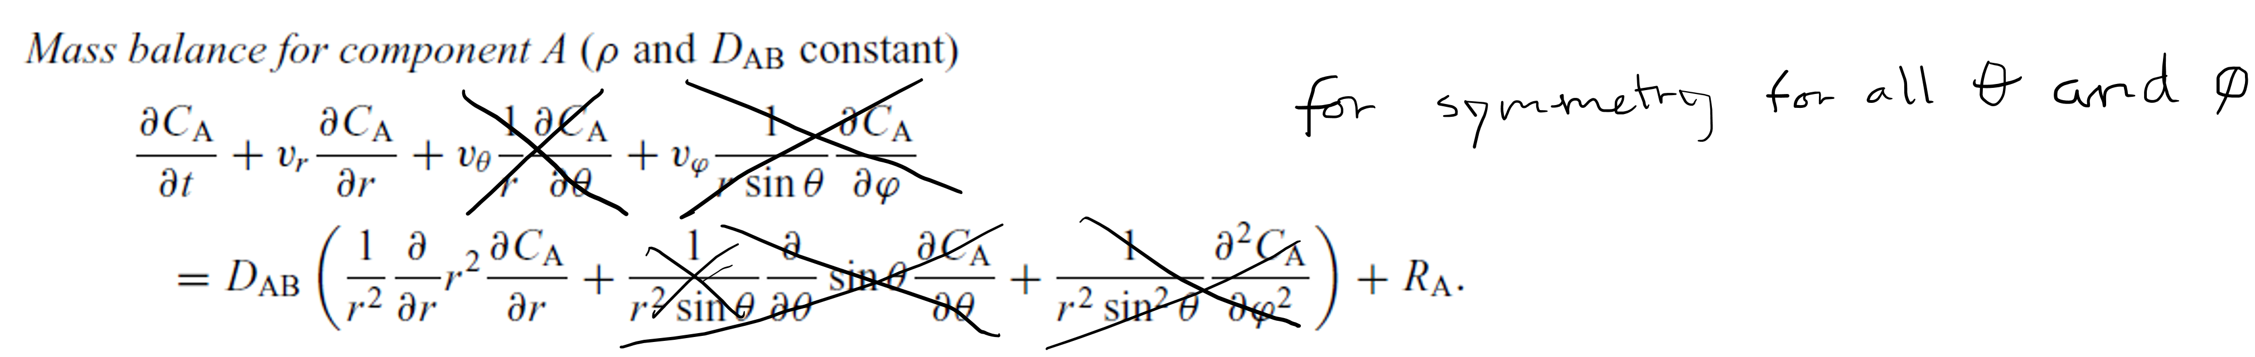
Spherical coordinates
Governing equation for mass
Governing equation for energy
Governing equation for mass

Slide 9
Choose coordinate system based on geometry of your model domain
What are your assumptions about mass and energy transport (directions for different modes of transfer)?
Eliminate terms starting from the PDE GEs in the book/slides

